Slide 1
NLP EMAIL CLASSIFICATION
TEAM MEMBERs
MR. Sai PRANEETH CHILIVERU
MS. JAYASHRI BHIVAJI GURULE
MS. ROHINI GOVIND ARKHADE
MR. PRANAV RAJENDRA BHoSALE
MR. NITHIN M
MR. SUBIN S NAir

Slide 2
CONTENTS
1. BUSINESS PROBLEM STATEMENT
2. OBJECTIVE
3. DETAILS SUMMARY OF DATA
4. EXPLORATRY DATA ANALYSIS
5. RECOMMENDATION
6. CONCLUSION

Slide 3
PROBLEM STATEMENT
Inappropriate emails would demotivates and spoil the positive environment that would lead to more attrition rate and low productivity and Inappropriate emails
The goal of the project is to identify such emails in the given day based on the above inappropriate content.

Slide 4
OBJECTIVE
Identifying emails that could be on form of bullying, racism, sexual favourtism and hate in the gender or culture, in today’s world so dominated by email no organization is immune to these hate emails.

Slide 5
DETAIL SUMMARY OF THE DATA
1.FIRST 30 COMMMENTS
2.LAST 30 COMMENTS
3.DATA SHAPE (48076,5)
4.CHECKING DATA TYPES
5.CHECKING NULL VALUES
6.CHECKING DUPLICATE VALUES

Slide 6
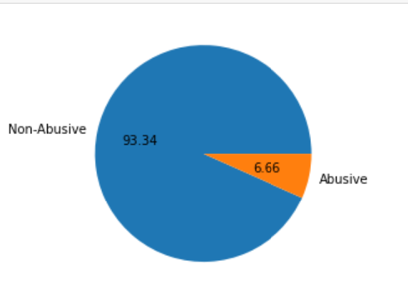
EDA
STUDY WITH THE PIE CHART
pie chart for Abusive and Non abusive
No number of emails=48076 nos
No of Abusive mail=44666 nos
No of Non Abusive mail=3410 nos

Slide 7
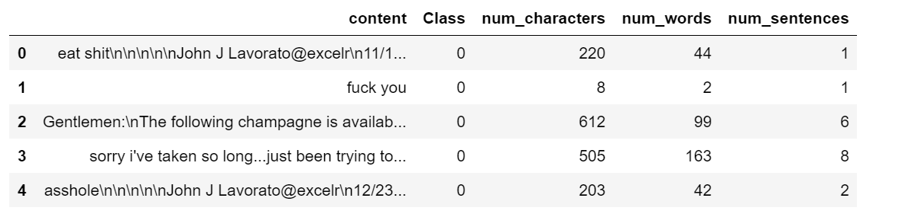
ANALYZING THE TEXT DATA
Here we take the count according to its characteristics

Slide 8
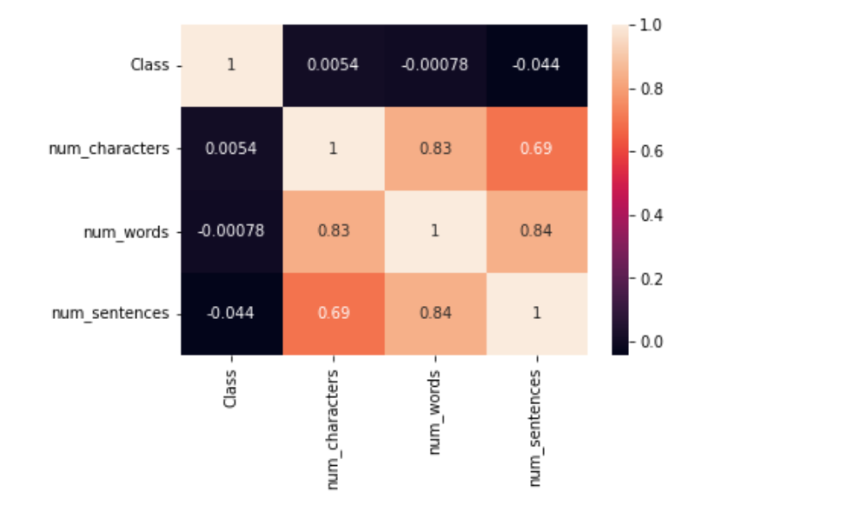
CORRELATION MATRIX
Here we have some strong correlation between columns

Slide 9
TEXT PREPROCESSING
1.REMOVE PUNTUATION
2.REMOVE STOPWORD
3.COMMON WORD REMOVAL
4.RARE WORD REMOVAL
5.SPELLING CORRECTION
6.TOKENIZATION
7.STEMMING
8.LEMMANIZATION

Slide 10
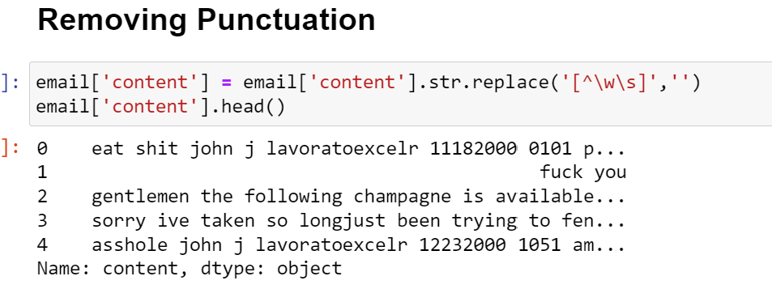
REMOVING PUNCTUATIONS
Here we removed punctuation from each and every sentences

Slide 11
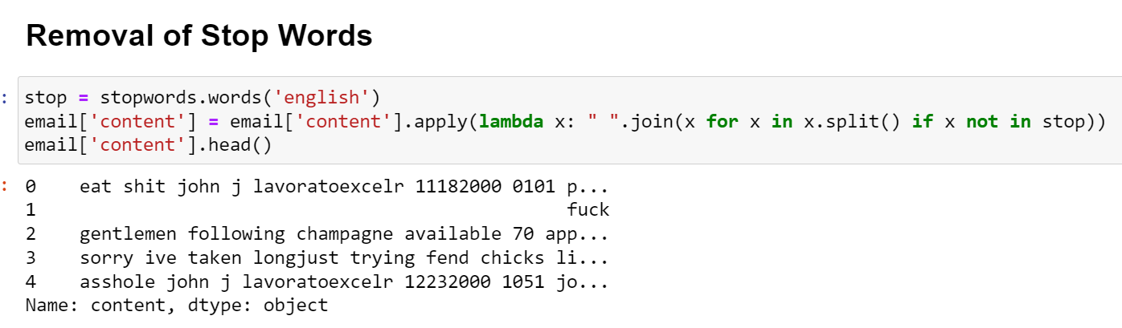
REMOVING STOP WORD
Here we removed stop words from each and every sentence

Slide 12
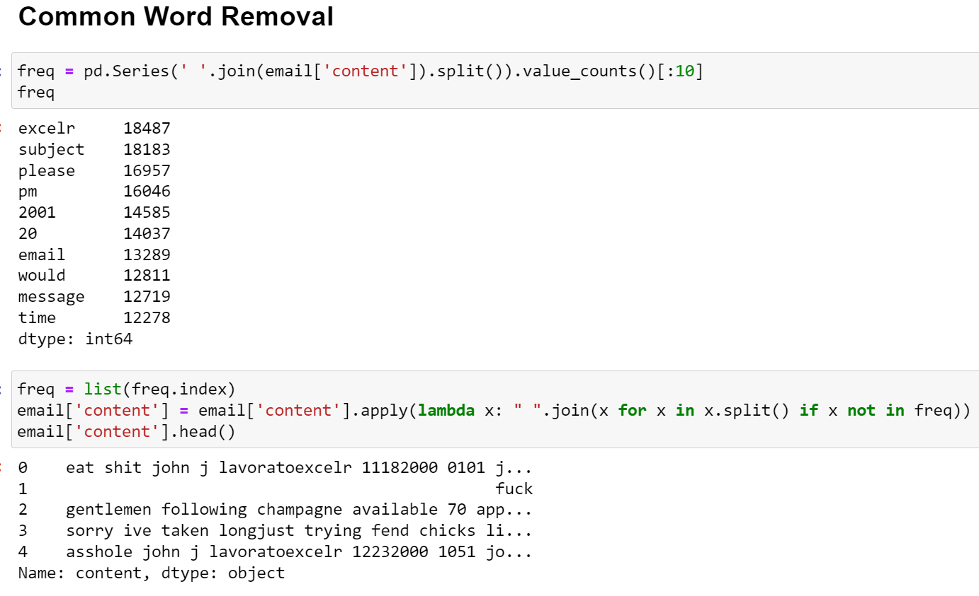
COMMON WORD REMOVAL
Here we remove common words from each sentences

Slide 13
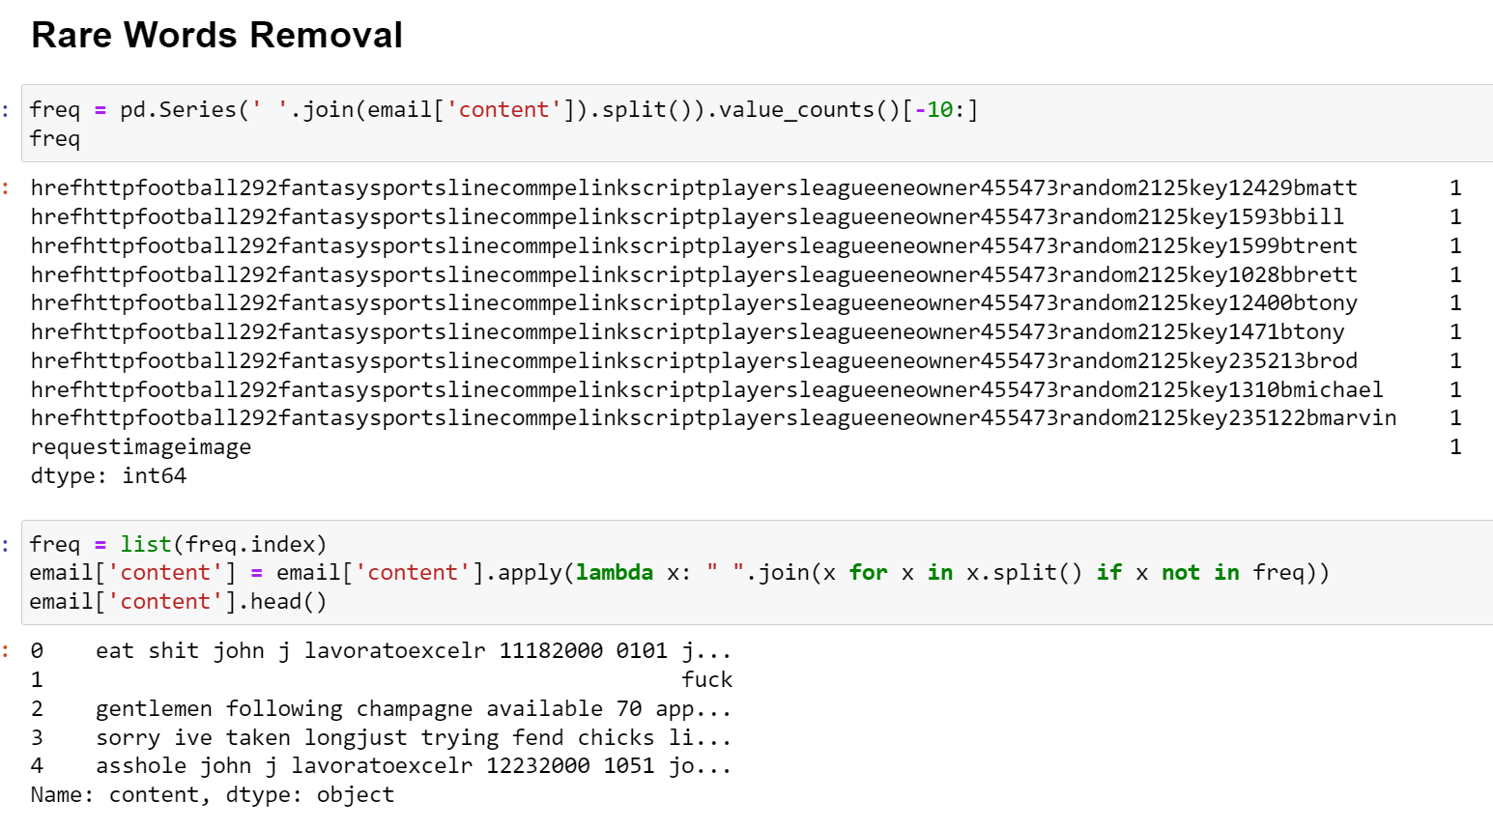
RARE WORD REMOVE
Here we removed all rare words from each sentences

Slide 14
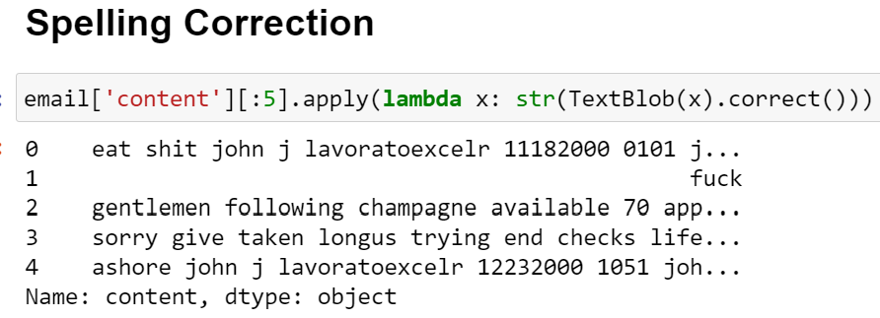
WORD SPELLING CORRECTION
Here we corrected spelling of each words from every sentences

Slide 15
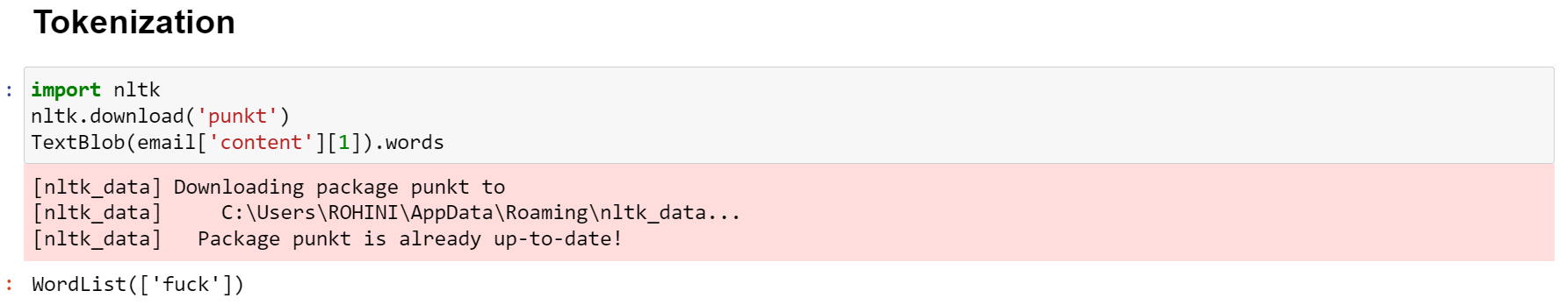
TOKENIZATION
Helps to break row text to words known as token

Slide 16
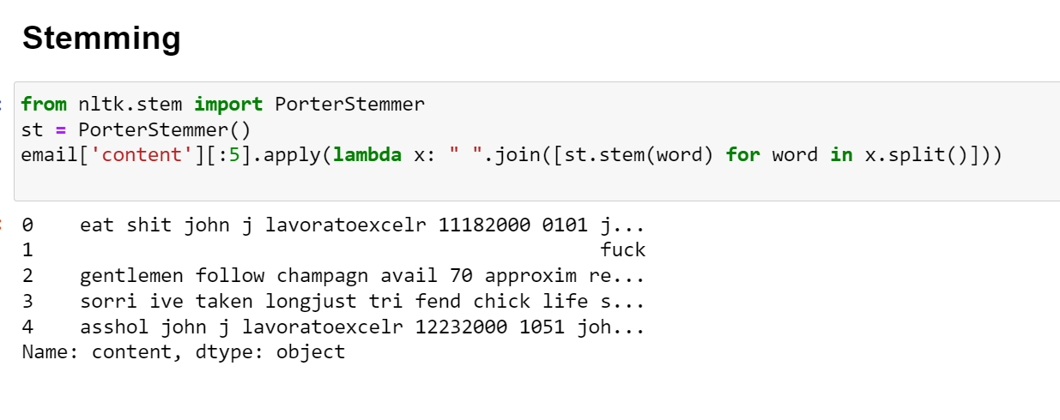
STEMMING
Helps to reduce words to their base form

Slide 17
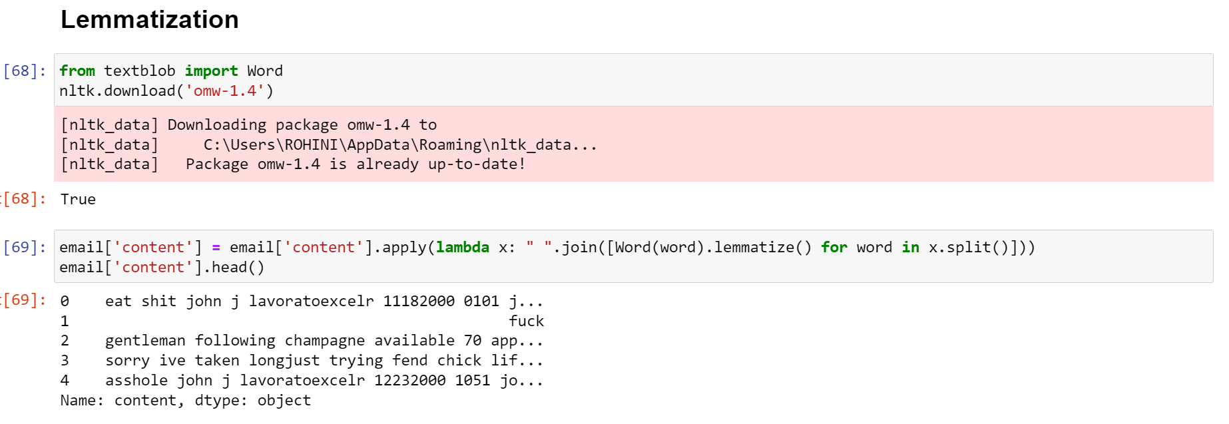
LEMMATIZATION
Grouping together the different infected form of word

Slide 18
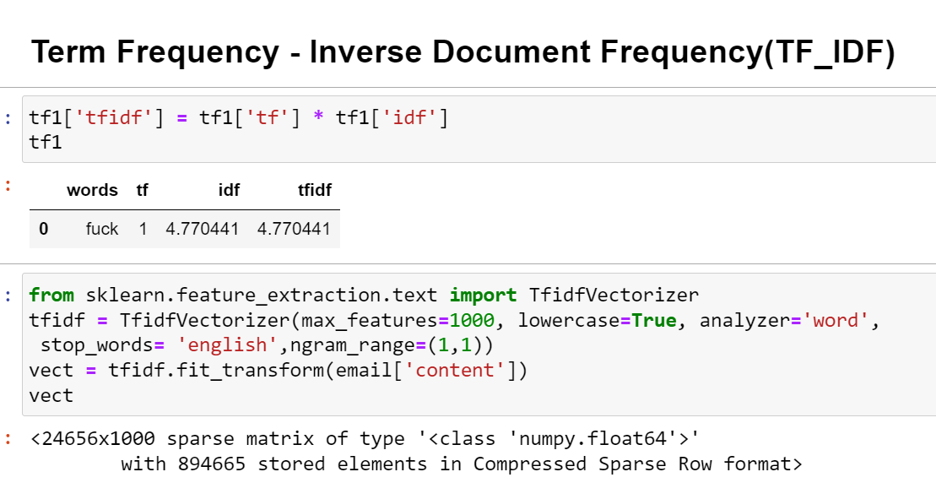
ADVANCED PREPROCESSING
Term Frequency - Inverse Document Frequency(TF_IDF)
BAG(Bag of Word)and World cloud

Slide 19
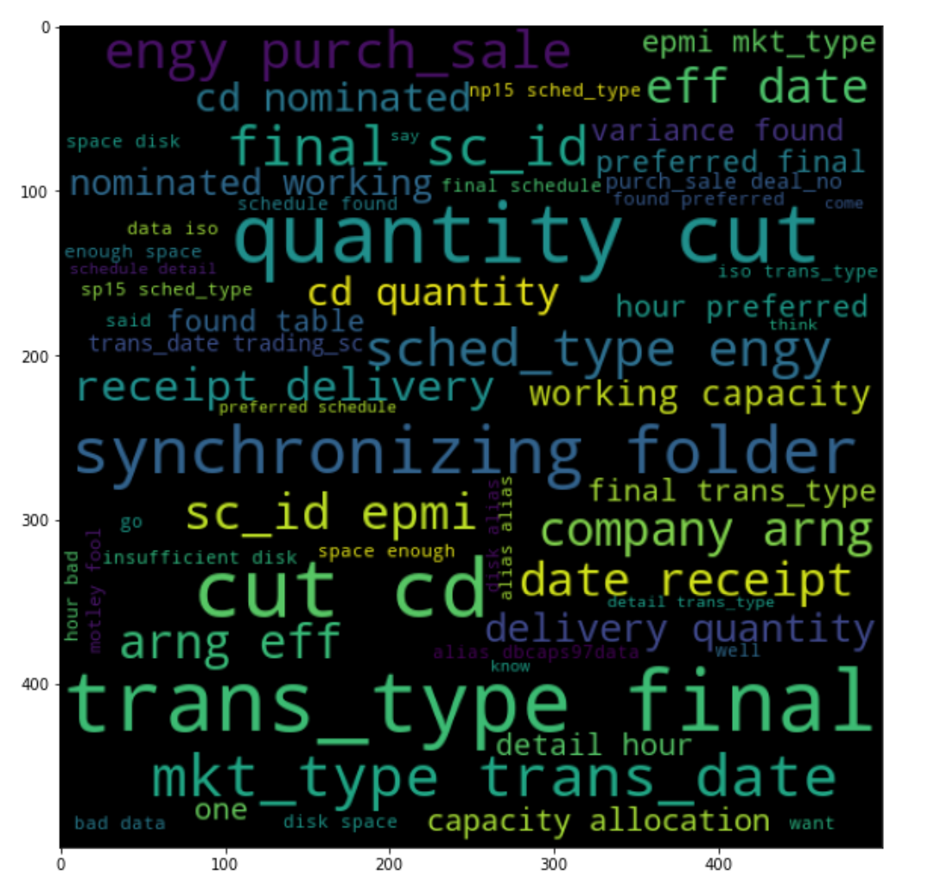
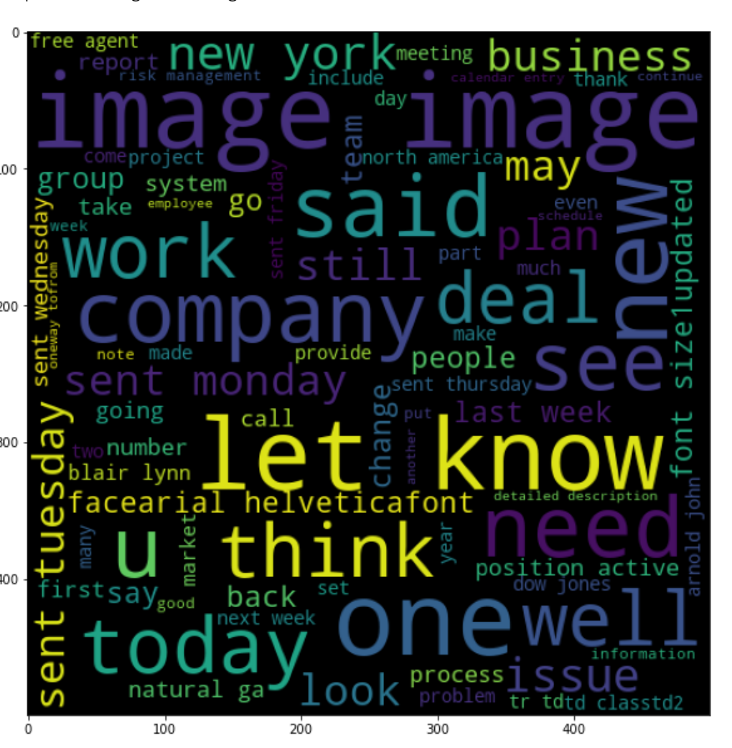
2.BAG(Bag of Word)and World cloud
Abusive
Non Abusive

Slide 20
FEATURE EXTRACTION
Tfidf Vectorizer
Imbalaning the text data

Slide 21
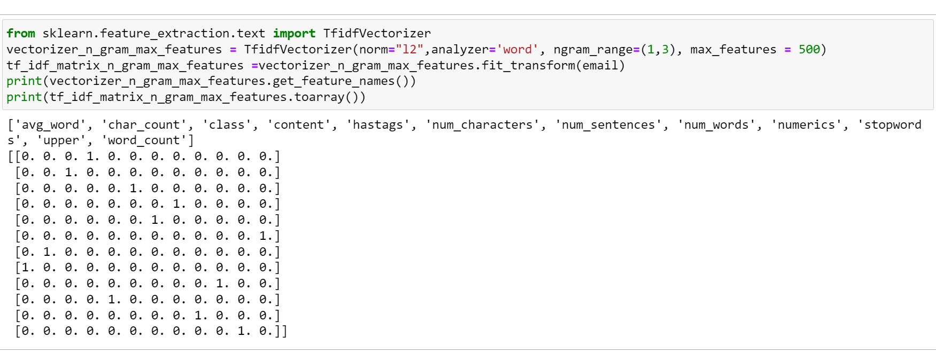
Tfidf Vectorizer
The Tfidf Vectorizer convert text data into numerical data

Slide 22
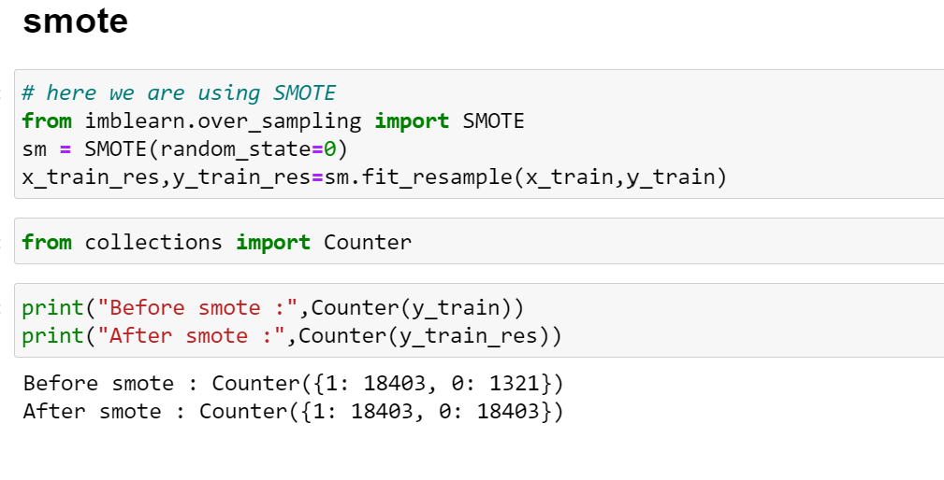
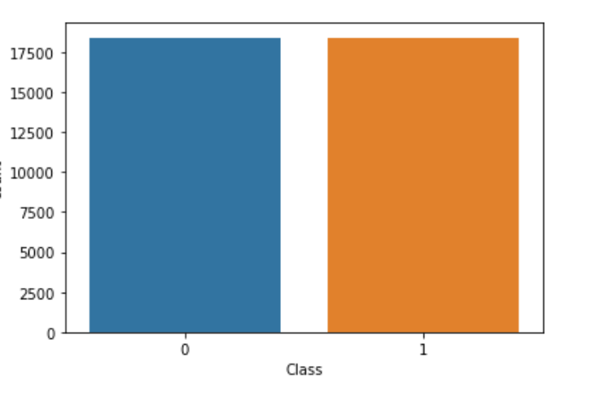
IMBALANING THE TEXT DATA USING SMOTE
Here the text data is balanced by using smote over sampling
Using barplot we can fint the data is balanced

Slide 23
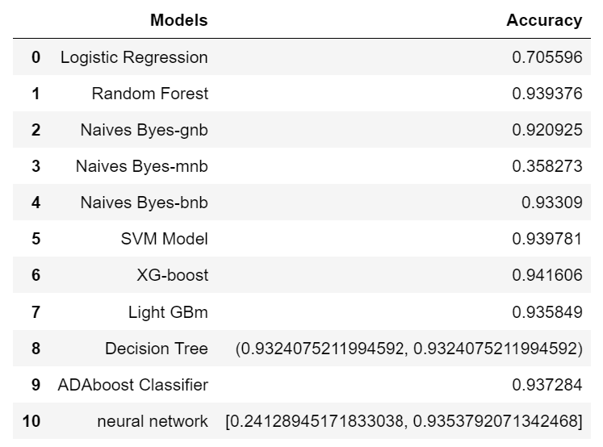
MODEL BUILDING
We take random forest algorithm as our final model

Slide 24
DEPLOYMENT
After the model building evaluation process , We have to deploy the code using “STREAMLIT”
We have selected the best model and used in our deployment

Slide 25
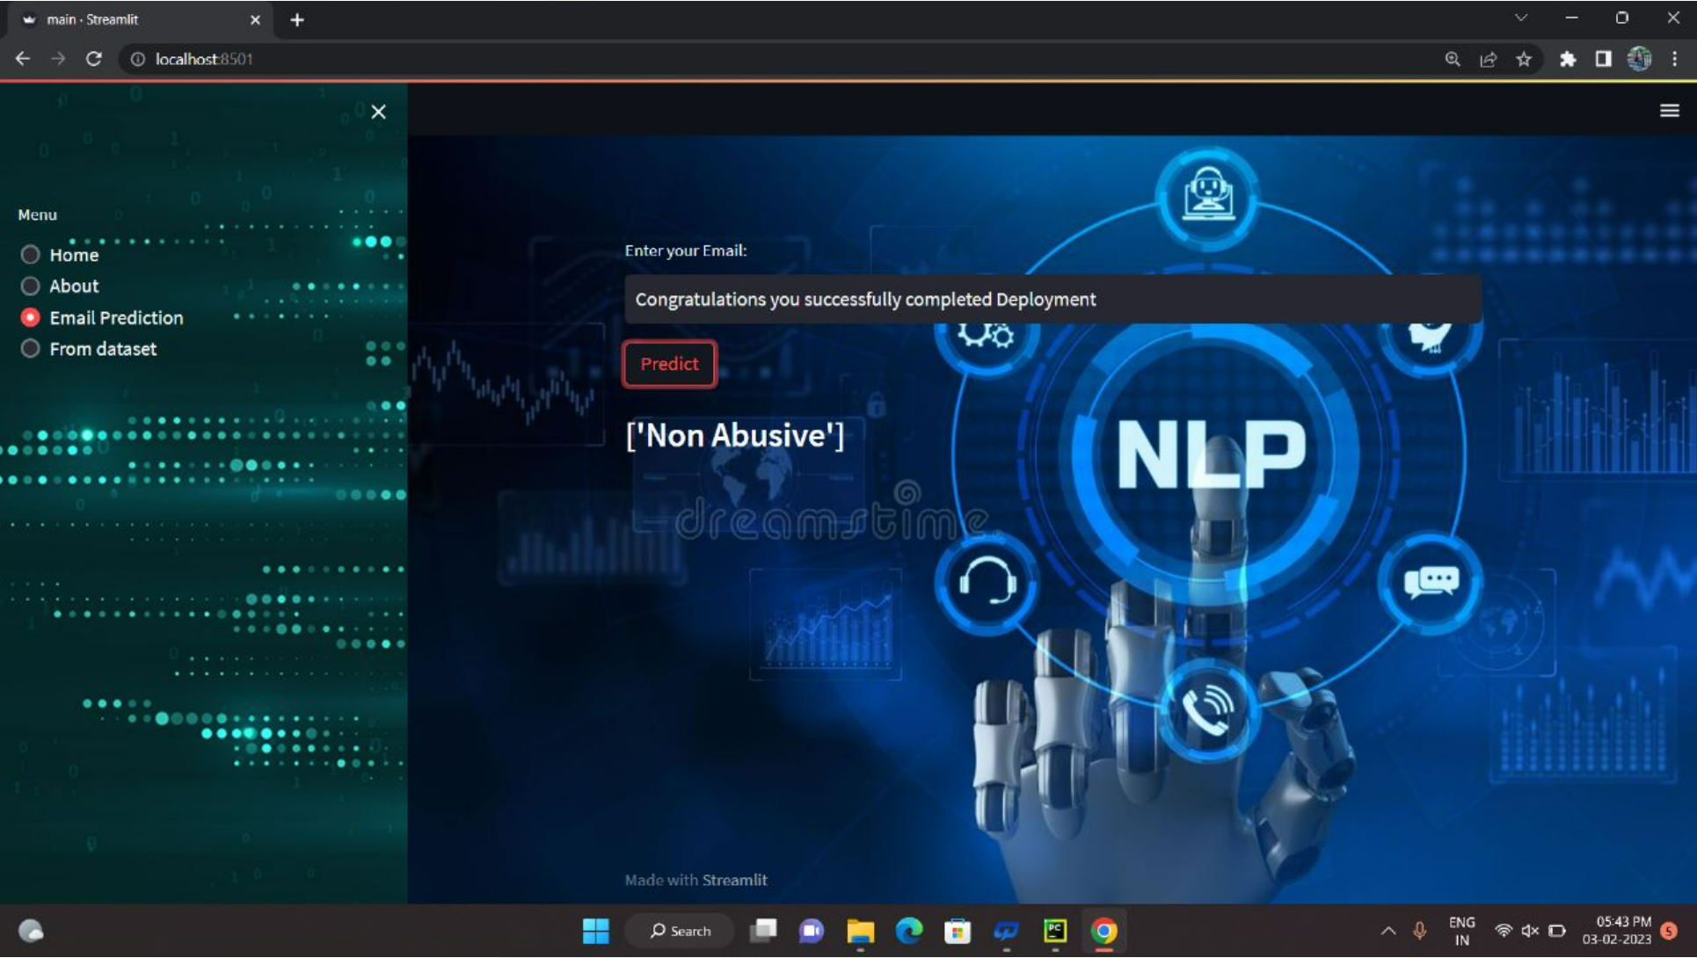
DEPLOYMENT

Slide 26
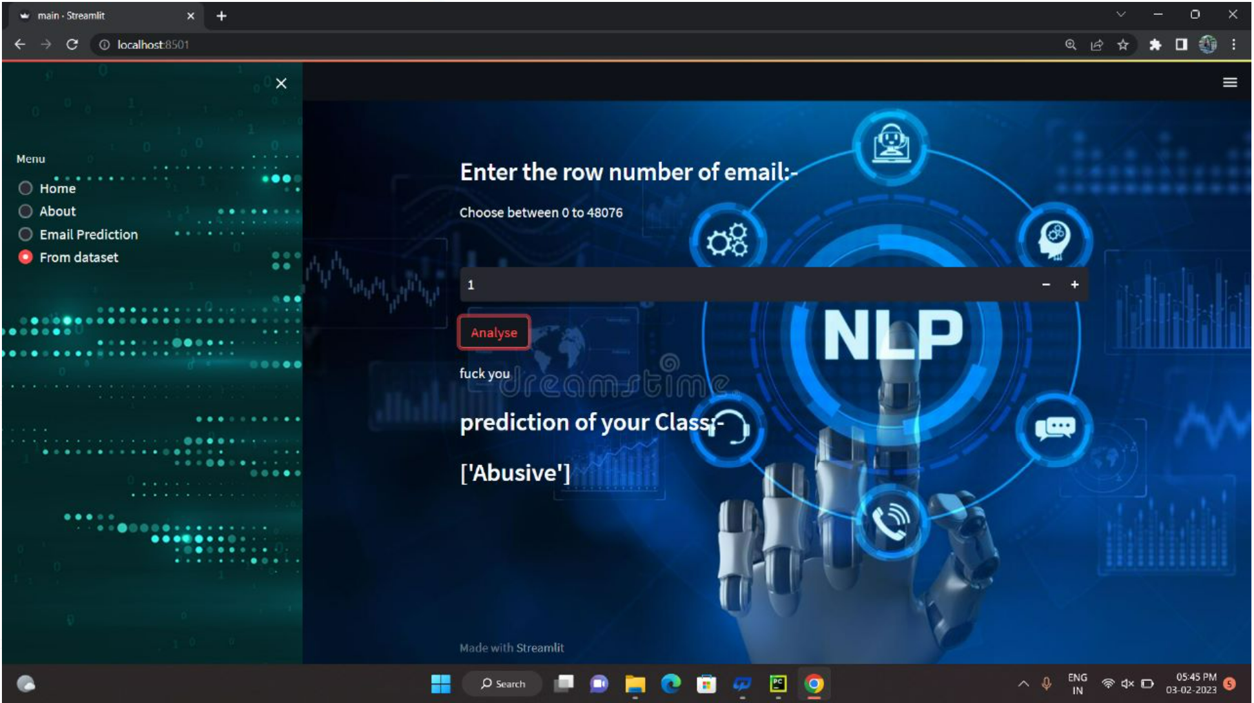
DEPLOYMENT

